Slide 1

SIDBI PMU Haryana
Progress Summary
March 2023

Slide 2

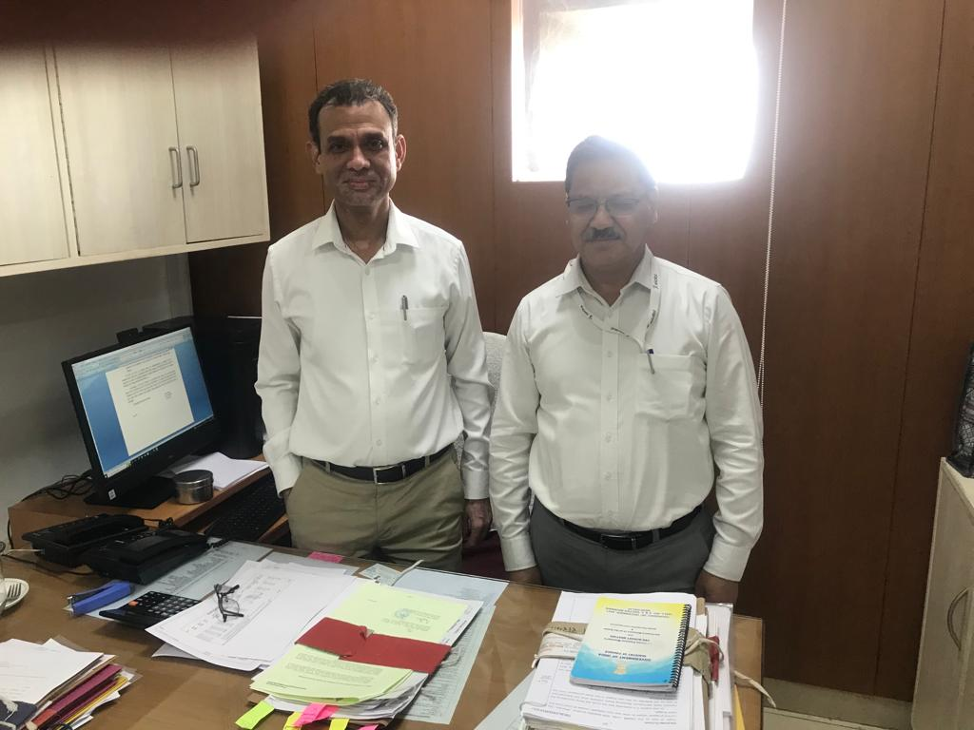
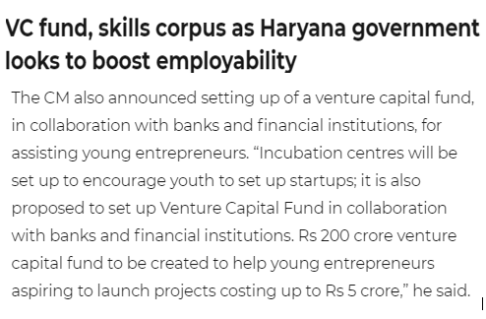

Key Themes & Highlights
TReDS
SCDF Master Agreement Signing
Venture Capital Fund
CGTMSE
Key Themes
01
02
03
04
TReDS
SCDF
Venture Capital Fund
CGTMSE

Slide 3
Trade Receivable e Discounting System (TReDS)
Advantages of TReDS
Objectives of TReDS
To facilitate financing of invoices/bills of MSMEs drawn on corporate and other buyers, including the Government Departments and PSUs, by way of discounting by financiers.
The participants in TReDS work together for facilitating, accepting, discounting, and settling invoices. As per the provisions of the Reserve Bank of India (RBI), only MSMEs (micro, small, and medium enterprises) can compete as sellers while NBFCs, banks and factoring companies are financiers.
TReDS transactions can be initiated by both the seller and the buyer for the financing of trade receivables of MSME sellers.
No recourse funding for the seller
Sellers, Corporates, other buyers including the Government Departments and PSUs, will have multiple choices for the factoring instruments.
No separate budgetary allotment from the State Govt. of Haryana
System is technology friendly and can be fully integrated to the ERP and SAP systems
Current Status
The file has been sent to the LR for obtaining their consent and approval over the shared draft MoUs for all the three firms. Once these approvals are obtained from the LR, the legally vet draft MoUs shall be shared with the three firms and an appropriate time will be sought from the concerned authorities for the signing of the MoUs.
RXIL TReDS
M1Xchange
A.TReDS

Slide 4
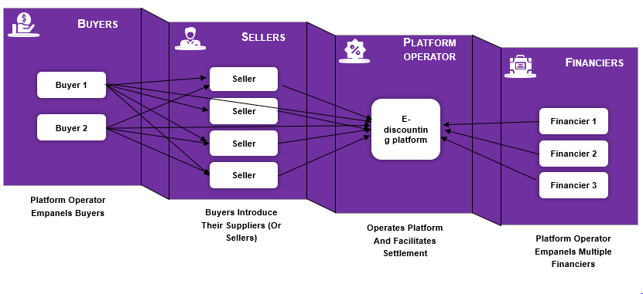
TReDS Brief
Way Forward
After the signing of the MoUs, efforts shall be made for the onboarding of other departments, PSUs, and other Government entities on the TReDS platform, bringing more transparency in the payments being made to the MSME suppliers and increasing the liquidity for the MSMEs. On a broader scale, payments made through TReDS shall be in sync with the vision of GoI to release the payment of the supplier MSMEs within 45 days of supply.

Slide 5
SIDBI Cluster Development Fund Scheme (SCDF)
Background
Low-cost lending window for State Government.
Purpose of financing of State Government to
create infrastructure towards development of MSME clusters.
3. Includes both Greenfield (induced clusters) and brownfield (existing clusters)
Further, the financing under the scheme would be done for proposals falling under any of the following categories:
Industrial and Agri-allied sectors in the MSME eco-space.
Social sectors in and around MSME clusters
Connectivity (Roads/Bridges) to MSME Clusters
Scheme Highlights
Rate of Interest = (Bank rate – 150 basis points).
The interest shall be payable on a quarterly basis.
The borrowing by the state Government under SCDF will be in the range of 80%-95% of the project cost.
It would also have a moratorium period of 2 Years and 11 months.
Directorate of MSME engagement
The Directorate is willing to avail the borrowings under the following schemes
MSE-CDP
Mini cluster scheme of Haryana
Cluster Plug and Play scheme
PADMA
Approval from Hon’ble Chief Minister
Concurrence from FD
Master agreement signed between GoH and SIDBI
10 projects sanctioned worth Rs.27.64 Crores
Tranche 1 Disbursement Initiation for 4 projects worth Rs. 7.71 Crores

Slide 6
SCDF advantages for the Directorate of MSME
As SCDF encompasses varied projects and is available on a reimbursement basis to the State Government of Haryana, the Directorate of MSME can opt for this low-cost lending window of loans and can reduce their overall cost of arranging funds.
More projects under the ambit of Cluster Plug and Play scheme, MSE-CDP, Mini cluster scheme and PADMA can be funded on the reimbursement basis.
Moreover, for the infrastructure development at the block level under the PADMA scheme, this scheme can be a crucial instrument for fund arrangement and implementation.
SCDF master agreement signing between FD, Haryana and SIDBI

Slide 7
Venture Capital Fund
Current status
The proposal has been approved by the Hon’ble CM, the file has been sent to obtain the concurrence of FD over the proposal and the drawdown schedule.
Once concurrence is obtained, file will be sent to LR for legal vetting of the Contribution Agreement.
Background
Fund of Funds – Creation of a Rs.10,000 crore Start-up fund by GoI.
Hon’ble Chief Minister of Haryana in his Budget 2022-23 speech informed the house regarding the setting up of a Venture Capital Fund.
Directorate of MSME, Haryana with SIDBI and SIDBI Venture Capital Limited (SVCL) had initiated the setting up of the Venture Capital fund for the state of Haryana.
A wide range of start-ups in Haryana engaged in growth sectors such as life sciences, retailing, light engineering, food processing, information technology, infrastructure related services, healthcare, logistics and distribution, etc. in the MSME sector can be funded.
Fund Registration number IN/AIF1/22-23/1117
Meeting with W/ACS (F) and W/ACS(I&C)
Approval from Hon’ble Chief Minister
Committee Formation
Proposal sent for obtaining Concurrence from FD over the proposal and the drawdown schedule

Slide 8
Fund Details
Venture Fund Details
Specifications | Details
SEBI Registration | IN/AIF1/22-23/1117 Category I Venture Capital Fund under SEBI (AIF) Regulations, 2012
Investment Manager | SIDBI Venture Capital Limited (SVCL)
Sponsor | Small Industries Development of India (SIDBI)
Target Fund Size | ₹350 crore including green shoe option of ₹100 crore
Fund Life | 10 years from date of final closing (plus 1+1-year extension)
Theme, Sector & Focus | Theme: Innovation Sector: Sector Agnostic Focus: Fintech, Green Tech, Agri & Food Processing, Healthcare, EdTech, auto components and light engineering etc
Target Commitments | Govt. of Haryana - ₹100 crore; SIDBI - ₹50 crore, Fund of Funds for Start-ups - ₹50 crore; Central/State PSUs and Overseas Contributors- ₹150 crore
Management Fee | Management Fee: 1.5%- 2% PA

Slide 9
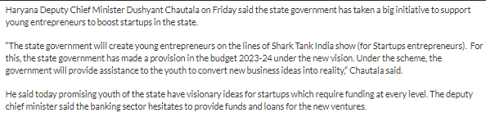
Way Forward
The formation of Venture Capital Fund would be highly beneficial for the growth and development of the Start-up ecosystem in Haryana, it will provide seed and revenue funding to approximately 100 start-ups.
In addition to directly impacting the Start-ups where the investment is done, the fund will also create an atmosphere of entrepreneurship which will lead to acceleration of growth and job creation in the entire Start-up ecosystem.
This would also attract more Venture Capital /Private Equity investment in the state, thus enabling the development of ancillary & supporting units as well.
News Snippet

Slide 10
CGT-MSE
Background
CGTMSE is jointly set up by Ministry of Micro and Small Enterprises (MSEs), Government of India, SIDBI to catalyse flow of institutional credit to MSEs.
CGTMSE extends a guarantee coverage of 75% - 85% of the individual loans given by the lending institutions with higher coverage to marginalized MSEs.
This acts as a deterrent for the lending institutions as the coverage is limited at max to 85% and still their 15% capital is at risk.
Proposal from CGTMSE
CGTMSE is willing to partner with state Govt. of Haryana to design a scheme where 75%-85% coverage will be provided by CGTMSE, and the balance coverage may come from the State Govt. to take the overall coverage to 90%-95% (less than 100%).
The State Government’s share will come out of a fund to
be placed by it with CGTMSE which will run and manage the scheme.
CGTMSE has already entered into arrangement with few states and is keen to initiate discussion to launch a special scheme on these lines.
Current Status
The meeting with W/ACS(I&C), Haryana and CEO of CGTMSE is scheduled on 22.03.23 to discuss the possibilities of the creation of the corpus fund for CGTMSE in the State of Haryana.

Slide 11
CGT-MSE
Way forward
The formation of a small corpus fund of Rs.100 Cr. in association with CGTMSE would further lead to bolstering of the state MSE ecosystem as it would leverage the lending institutions, NBFCs etc. to lend the MSEs without hesitation (due to higher credit coverage) and at the same time MSEs can also take advantage of such an established arrangement, hence, inviting more investment and job creation in the state.
Sr No | CGTMSE Coverage in % | State Govt. Share in % | Avg Turnover of MSEs | Avg Loan Ticket size | Contribution by GoH in Lakhs | Corpus by GoH in Cr. | Portfolio Size in Cr. | MSEs benefitted
1 | 85 | 10 | 25,00,000 | 5,00,000 | 0.50 | 100 | 5,000 | 1,00,000
2 | 75 | 15 | 50,00,000 | 10,00,000 | 1.50 | 100 | 5,000 | 50,000

Slide 12
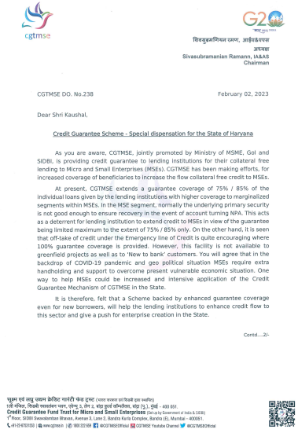
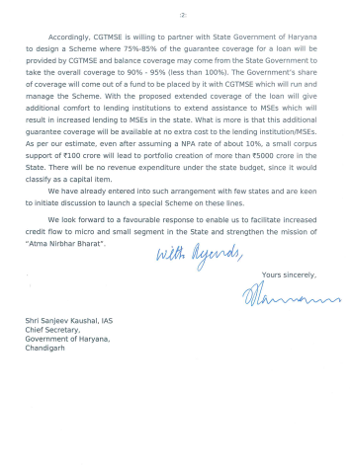
CGT-MSE

Slide 13

Contact us
NEW DELHI National Office, Outer Circle, L 41, Connaught Circus, New Delhi - 110001 T +91 11 4278 7070 | NEW DELHI 6th Floor, Worldmark 2, Aerocity, New Delhi - 110037 T +91 11 4952 7400 | BENGALURU 5th Floor, 65/2, Block A, Bagmane Tridib, Bagmane Tech Park, CV Raman Nagar, Bengaluru - 560093 T+91 80 4243 0700 | CHANDIGARH B-406A, 4th Floor, L&T Elante Office Building, Industrial Area Phase I, Chandigarh - 160002 T +91 172 4338 000 | CHENNAI 9th Floor, A Wing, Prestige Polygon, 471 Anna Salai, Mylapore Division, Teynampet, Chennai - 600035 T +91 44 4294 0000
DEHRADUN Suite No 2211, 2nd Floor, Building 2000, Michigan Avenue, Doon Express Business Park, Subhash Nagar, Dehradun - 248002 T +91 135 2646 500 | GURGAON 21st Floor, DLF Square, Jacaranda Marg, DLF Phase II, Gurgaon - 122002 T +91 124 462 8000 | HYDERABAD 7th Floor, Block III, White House, Kundan Bagh, Begumpet, Hyderabad - 500016 T +91 40 6630 8200 | KOCHI 6th Floor, Modayil Centre Point, Warriam Road Junction, MG Road, Kochi - 682016 T +91 484 406 4541 | KOLKATA 10C Hungerford Street, 5th Floor, Kolkata - 700017 T +91 33 4050 8000
MUMBAI 11th Floor, Tower II, One International Center, SB Marg Prabhadevi (W), Mumbai - 400013 T +91 22 6626 2600 | MUMBAI Kaledonia, 1st Floor, C Wing, (Opposite J&J Office), Sahar Road, Andheri East, Mumbai - 400 069 T +91 22 6626 2600 | NOIDA Plot No 19A, 2nd Floor, Sector - 16A, Noida - 201301 T +91 120 485 5900 | PUNE 3rd Floor, Unit No 309-312, West Wing, Nyati Unitree, Nagar Road, Yerwada Pune - 411006 T +91 20 6744 8800
For more information or for any queries, write to us at gtbharat@in.gt.com
Follow us @GrantThorntonIN
© 2021 Grant Thornton Bharat LLP. All rights reserved.
“Grant Thornton Bharat” means Grant Thornton Advisory Private Limited, the sole member firm of Grant Thornton International Limited (UK) in India, and those legal entities which are its related parties as defined by the Companies Act, 2013, including Grant Thornton Bharat LLP.
Grant Thornton Bharat LLP, formerly Grant Thornton India LLP, is registered with limited liability with identity number AAA-7677 and has its registered office at L-41 Connaught Circus, New Delhi, 110001.
References to Grant Thornton are to Grant Thornton International Ltd. (Grant Thornton International) or its member firms. Grant Thornton International and the member firms are not a worldwide partnership. Services are delivered independently by the member firms.

